Slide 1
Preparedness of State Govt., for ensuing summer season.
Revenue (DM) Department,
Government of Telangana

Slide 2
Vision
“To build a safe and disaster resilient Telangana by developing a holistic, proactive, multi-disaster oriented and technology driven strategy through a culture of prevention, mitigation, preparedness and response.”

Slide 3
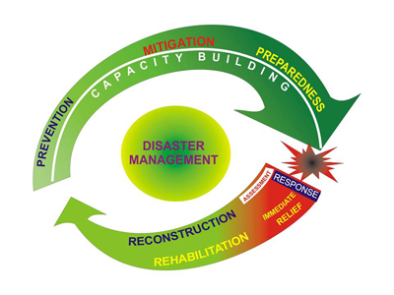
Disaster Management Continuum
Pro active Strategy
Holistic & continuous process
Fundamental to prompt & effective response

Slide 4
Approach
Preparedness to deal with any disaster.
Mitigation or reduction of risk of any disaster or its severity or consequences.
Prevention of danger or threat of any disaster.
Capacity building including research and knowledge management.
Prompt response to any threatening disaster situation or disaster.
Assessing the severity or magnitude of effects of any disaster
Evacuation, rescue and relief.
Rehabilitation and reconstruction.

Slide 5
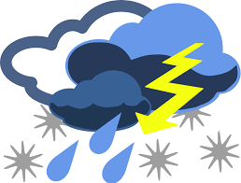
Extreme weather events in Summer
Unseasonal Rains/Hailstorms/Thunder storms.
Heat waves
Drought/Drinking water scarcity.
Fire Accidents/Forest fires.

Slide 6
Review meetings
Chief Minister (Season)
Chief Secretary (Fortnight)
Commissioner for DM – State Nodal Officer (Daily)
District Collectors – District Nodal Officers (Daily)
Municipal Commissioners – Urban Nodal Officers (Daily)
IMD
I & PR
PR & RD
MA & UD
Labour & Employment
Agriculture
Animal Husbandry
Medical & Health
Transport – TSRTC
Education
Endowment Dept.,
Electricity Dept.,
Tourism Dept.,
Forest Dept.,
IT Dept.

Slide 7
Preparedness measures
Awareness generation
Inform people about care and protection of extreme weather events in summer.
Creation of awareness through different forms of media
Developing & Designing information materials in local languages.
Training & Capacity Building
Formulate & implement trainings & capacity building activities.
Implement effective training programs for officials at various levels, elective representatives, community leaders, civil society organisations, etc
Mainstreaming of Disaster Management Plans
Effective implementation of SDMP.
Formulation of DDMPs & its implementation.
District specific Plans for Heat wave.

Slide 8
Preparedness measures (contd..)
Preventive measures
Build water conservation structures like check dams ; reservoirs with excess capacity and ground water recharge augmentation systems.
Restoration of tanks – Mission Kakatiya.
Providing storage facilities like drinking water , fodder in fodder banks and rain harvesting systems.
Providing best & healthy drinking water to rural & urban areas – Mission Bhagiratha.
Reducing climate change impact by implementing various water and soil conversation programmes.
Preparation, implementation and review of contingency plan.
Mitigation Measures
Promote water efficient irrigation systems
Promote protective irrigation through micro irrigation systems.
Promote village level information systems for natural resource management.
Afforestation – Haritha Haram
Response Measures
Need based credit for farmers
Promote financial inclusion
Ensure Insurance programs & Relief assistance.

Slide 9
Monitor weather Forecasts
IMD
Notifying disaster alerts
Identifying high risk areas by mapping
Mobile service providers are requested to send SMS alerts to the public
Updation

Slide 10
Dissemination of Disaster alerts
SEOC
DEOC
Mandal
Admin.
Municipal
Admin.
HODs
IMD
Village
Admin.

Slide 11
‘Disaster preparedness - for effective
response and to “Build Back Better”
in recovery, rehabilitation and reconstruction’

